Slide 1

Eat.
Learn.
Do.
SEPT
25
2025
with
Content That Converts:
Creating Social Media
That Can’t Be Ignored
10:30 AM - 1:30 PM
4201 Main St Suite 200, Houston, TX 77002

Slide 2



Welcome
Content That Can't Be Ignored: The Strategic Framework Houston Businesses Need
01
02
Partnership announcement with Industrious
Today you'll learn the theory AND leave with a professional reel
03

Slide 3

The Stakes for Houston Businesses
"76% of potential clients judge your service quality before they ever contact you"
"Most Houston businesses are caught in the content creation hamster wheel"
Visual: Professional business vs. amateur digital presence impact

Slide 4

What You’ll Master Today
Strategic framework for effective content creation
Content psychology that drives action
Hands-on reel creation using professional methods
Leave with: Strategy knowledge + 1 professional reel ready to post

Slide 5
The Psychology Behind Content That Works
Section 1
The Social Content Company

Slide 6



Content Theory Fundamentals
Content theory: Understanding what motivates people to engage and act
The difference between content that gets scrolled past vs. content that drives action
Basic psychological triggers in content consumption

Slide 7



The Three Business Evolution Phases
Phase 1
Phase 2
Phase 3
"I JUST NEED TO CREATE CONTENT"
"I NEED TO CREATE GOOD CONTENT"
“I NEED TO CREATE GOOD CONTENT THAT MOTIVATES PEOPLE TO PURCHASE"

Slide 8

The Business Impact Reality
"Why content psychology matters for Houston businesses:"
Consistent client acquisition vs. feast-famine cycles
Premium positioning vs. commodity pricing
Systematic growth vs. random results
"Content psychology drives business psychology"

Slide 9
Let’s Check-In
Raise your hand if this sounds like you:
"I post when I remember to"
"I'm not sure if my content is working"
"I feel like I'm shouting into the void"
"I get likes but not clients"

Slide 10
The Customer Journey Content Framework
Section 2
The Social Content Company

Slide 11


Understanding the Customer Journey
Content funnel visual: AWARENESS → INTEREST → CONSIDERATION → INTENT → PURCHASE
"Every piece of content should move people through this journey"
"The key: Know WHERE your audience is and create content for THAT stage"

Slide 12
Content By Journey Stage – Detailed Breakdown
WARM (Interest/Consideration):
COLD (Awareness):
HOT (Intent/Purchase):
Educational, helpful, no selling
Problem agitation, solution introduction
Social proof, specific offers, calls-to-action

Slide 13
The Critical Mistake Most Make
"DON'T DISRUPT THE FUNNEL"
"Example: Selling to cold audience = immediate scroll-past"
"Why most content fails: Wrong content for wrong audience temperature"

Slide 14



The Houston Market Advantage
"Finding content gaps in your local market"
Research method: "Study what competitors AREN'T saying"
"If they aren't talking about it, YOU talk about it"

Slide 15


Let’s Do Gap Analysis
Participants list:
Top 3 competitors
Their most common content themes
One topic they DON'T cover that they should

Slide 16
Platform Strategy for Local Businesses
Section 3
The Social Content Company

Slide 17
Platform Selection Reality
"Being everywhere isn't a strategy - it's a recipe for mediocrity everywhere"
"Quality domination beats quantity distribution"
Platform preferences by business type

Slide 18
The Reel Revolution
"Why video content dominates in 2025"
"Instagram Reels vs. TikTok vs. YouTube Shorts"
"How to create once, adapt everywhere"

Slide 19


Reel Psychology & Performance
"What makes people stop scrolling"
"The 3-second rule and hook psychology"
"Engagement patterns that drive reach"

Slide 20
Reel Creation Strategy
Section 4
The Social Content Company

Slide 21
The Anatomy of a High-Converting Reel
Hook (first 3 seconds)
Value delivery (middle section)
Call-to-action (final moment)
Visual elements that maintain attention

Slide 22
Reel Formats That Work for Business
Educational tips
Behind-the-scenes
Quick transformations
Day-in-the-life content

Slide 23

Technical Excellence Basics
Lighting fundamentals
Audio quality importance
Framing and composition
Editing for engagement retention

Slide 24
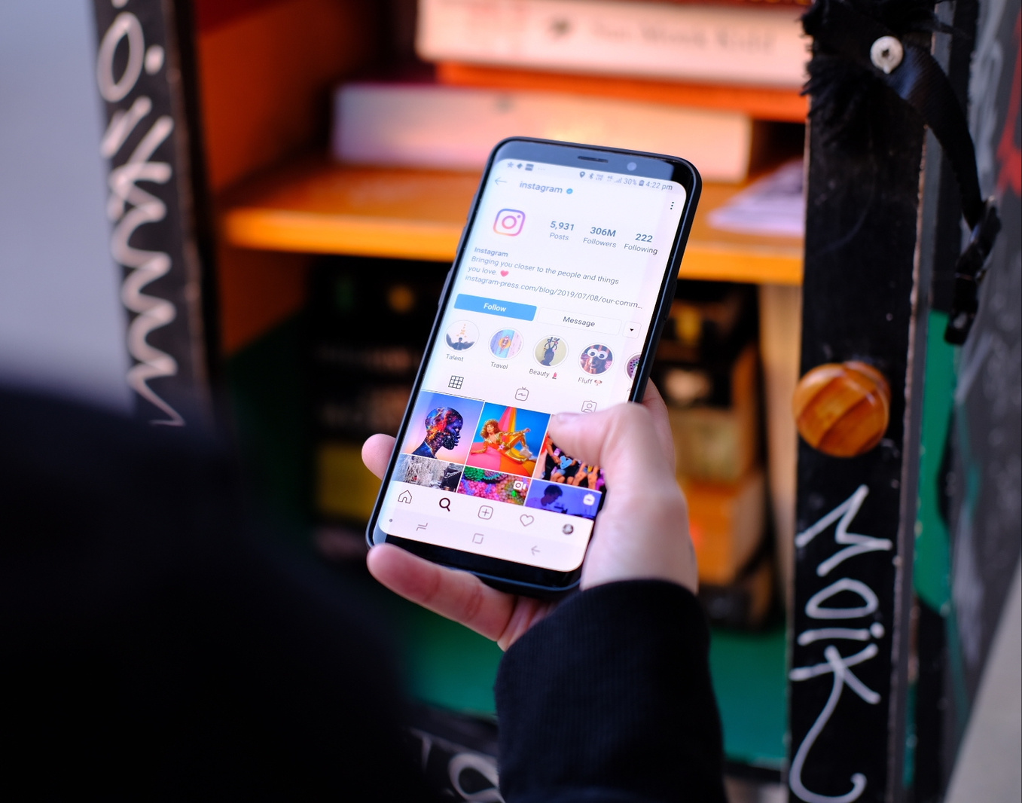
Let’s Plan a Reel
Based on your gap analysis, what's ONE educational tip you could share in a 30-second reel?

Slide 25
Live Reel Creation Session
The Social Content Company

Slide 26
Content Planning & Scripting
Round 1
The Social Content Company

Slide 27
Professional Reel Production
Round 2
The Social Content Company

Slide 28
Review & Feedback
Round 3
The Social Content Company

Slide 29

Thank You

